Slide 1
Instructor Materials Chapter 11: Printers
IT Essentials v6.0
Notes:
Cisco Networking Academy Program
IT Essentials
Chapter 11: Printers

Slide 2
Instructor Materials - Chapter 11 Planning Guide
This PowerPoint is divided in two parts:
Instructor Planning Guide
Information to help you become familiar with the chapter
Teaching aids
Instructor Class Presentation
Optional slides that you can use in the classroom
Begins on slide #10
Note: Remove the Planning Guide from this presentation before sharing with anyone.
Notes:
2

Slide 3
ITE 6.0 Planning Guide
Chapter 11: Printers
Notes:
ITE 6.0 Planning Guide
Chapter 6: Printers

Slide 4
Chapter 11: Activities
What activities are associated with this chapter?
Page Number | Activity Type | Activity Name
11.1.2.4 | Interactive Activity (IA) | Laser Printing Process
11.2.1.6 | Lab | Install a Printer in Windows 8
11.2.1.6 | Lab | Install a Printer in Windows 7 and Vista
11.3.2.5 | Lab | Share a printer in Windows 8
11.3.2.5 | Lab | Share a printer in Windows 7 and Vista
Notes:
4

Slide 5
Chapter 11: Assessment
Students should complete Chapter 11, “Assessment” after completing Chapter 11.
Quizzes, labs, and other activities can be used to informally assess student progress.
Notes:
5

Slide 6
Chapter 11: Best Practices
Prior to teaching Chapter 11, the instructor should:
Complete Chapter 11, “Assessment.”
The goal of this chapter is to understand the process to install, configure, share, and maintain printers.
It is important to become familiar with different type of printers currently available.
The students should be able to describe the installation and configuration process for printers.
Make sure that the students understand the potential safety hazards and safety procedures associated with printers and scanners.
The students should become familiar with the maintenance and troubleshooting processes and common problems for printers.
Notes:
6

Slide 7
Chapter 11: Additional Help
For additional help with teaching strategies, including lesson plans, analogies for difficult concepts, and discussion topics, visit the ITE Community at community.netacad.net.
If you have lesson plans or resources that you would like to share, upload them to the ITE Community in order to help other instructors.
Notes:
7

Slide 8
Chapter 11: Topics in chapter that are not found in the CompTIA A+ 220-901 Certification
This slide lists content included in this chapter that is NOT listed in the CompTIA A+ 220-901 blueprint. Instructors could skip these sections; however, they should provide additional information and fundamental concepts to assist the student with the topic.
All content in Chapter 11 is aligned to the certification.
Notes:
8

Slide 9


Slide 10
Chapter 11: Printers
IT Essentials v6.0
Notes:
Cisco Networking Academy Program
IT Essentials
Chapter 11: Printers

Slide 11
Chapter 11 - Sections & Objectives
11.1 Common Printer Features
Explain the purpose and characteristics of different types of printers.
11.2 Installing and Configuring Printers
Install a printer.
11.3 Sharing Printers
Configure printer sharing.
11.4 Maintaining and Troubleshooting Printers
Explain how to improve printer availability
11.5 Chapter Summary
Notes:
11

Slide 12
11.1 Common Printer Features
Notes:
Cisco Networking Academy Program
IT Essentials
Chapter 11: Printers

Slide 13
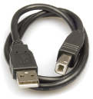
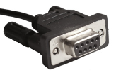
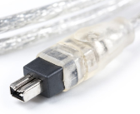
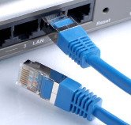
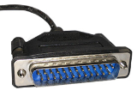
Common Printer Features Characteristics and Capabilities
Characteristics to consider when choosing a printer
Capabilities and speed
Color or Black and White
Quality
Reliability
Cost of ownership
Can you name these connection types and their characteristics?
Notes:
11.1 – Common Printer Features
11.1.1 – Characteristics and Capabilities

Slide 14
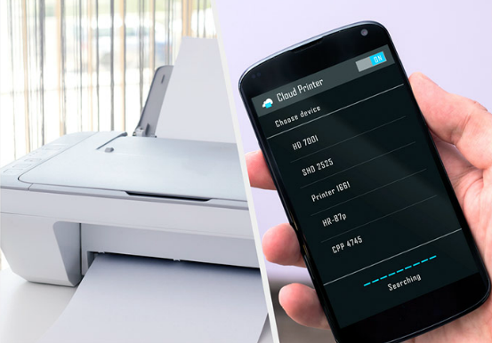
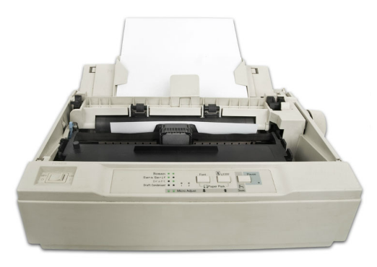
Common Printer Features Printer Types
Inkjet
High quality printer
Spray technology
Laser
High-quality, fast printer
Uses a laser beam to create an image
Thermal
Some retail cash registers or older fax machines
Uses heat for image generation
Impact
Has carbon-copy printing ability
Print heads strike an inked ribbon
Virtual
Sends the print job to a file or to a remote destination in the cloud
Notes:
11.1 – Common Printer Features
11.1.2 – Printer Types

Slide 15
11.2 Installing and Configuring Printers
Notes:
Cisco Networking Academy Program
IT Essentials
Chapter 11: Printers

Slide 16
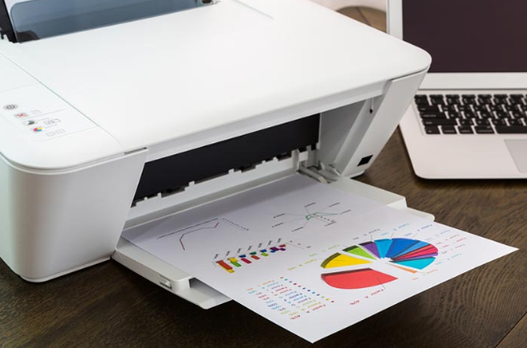
Installing and Configuring Printers Installing and Updating a Printer
Follow the manufacturer’s directory when connecting the printer.
Printer software can be installed using the installation CD or tools from the manufacturer’s website. Use the latest version if available.
Every printer uses its unique printer driver and software that allows communications between printer and computer.
PDL describes the appearance of the document
Postscript allows fonts and text types to be identical on the screen and on paper
Check regularly for printer driver updates from the manufacturer
After printer installation or printer driver updates, print test pages to verify the printer is working properly. Roll back the update if necessary.
Notes:
11.2 – Installing and Configuring Printers
11.2.1 - Installing and Updating a Printer

Slide 17
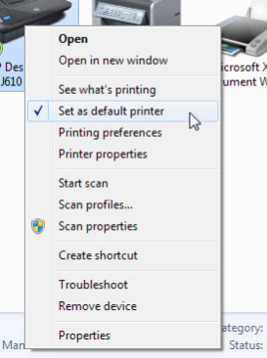
Installing and Configuring Printers Configuring Options and Default Settings
Some common printer configuration settings are: paper type, print quality, and paper size. Can you name a few more?
Printers can be configured using the global or per document methods
From the Control Panel in the Printers and Faxes or Devices and Printers section, a default printer can be set for all the print jobs.
Notes:
11.2 – Installing and Configuring Printers
11.2.2 – Configuring Options and Default Settings

Slide 18
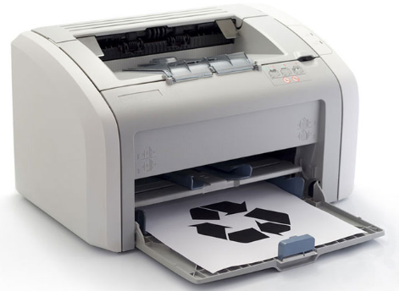
Installing and Configuring Printers Optimizing Printer Performance
Most printer optimization is done through software supplied with the printer driver.
Printer spooling settings
Color calibration
Paper orientation
Some printers updated through hardware optimization
Firmware upgrades
Printer memory upgrades
Notes:
11.2 – Installing and Configuring Printers
11.2.3 – Optimizing Printer Performance

Slide 19
11.3 Sharing Printers
Notes:
Cisco Networking Academy Program
IT Essentials
Chapter 11: Printers

Slide 20
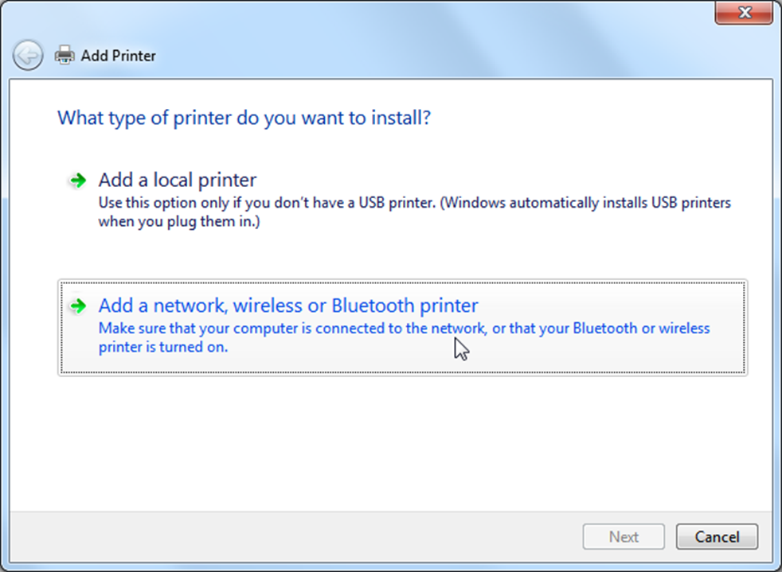
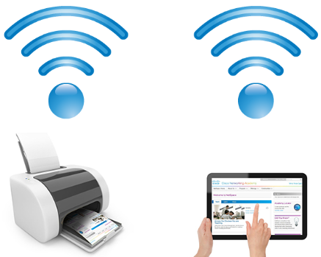
Sharing Printers Operating System Settings for Sharing Printers
Printers can be shared on a network or using wireless or Bluetooth connections.
Printer sharing can be configured in the Network and Sharing Center in the Control Panel.
Shared printers can be connected using wired or wireless methods.
To connect to a shared printer, navigate to the Control Panel. Choose Printers or Devices and Printers to add a printer.
Notes:
11.3 – Sharing Printers
11.3.1 – Operating System Settings for Sharing Printers

Slide 21
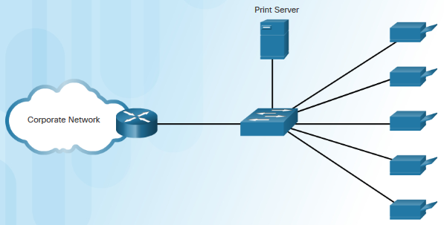
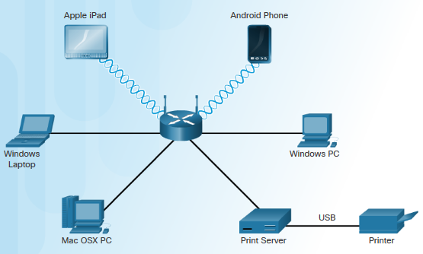
Sharing Printers Print Servers
Print servers allows multiple computer users to access a single printer.
Print servers has three functions:
Provide client access to print sources
Queue and send print jobs
Provide feedback to Account Creation
Three types of print servers
Software – installed on a client computer
Hardware – connects the network and communicates with the printer
Dedicated – used in a large network with multiple LANs
Can you name the print server type used based on the topology below?
Notes:
11.3 – Sharing Printers
11.3.2 – Print Servers

Slide 22
11.4 Maintaining and Troubleshooting Printers
Notes:
Cisco Networking Academy Program
IT Essentials
Chapter 11: Printers

Slide 23
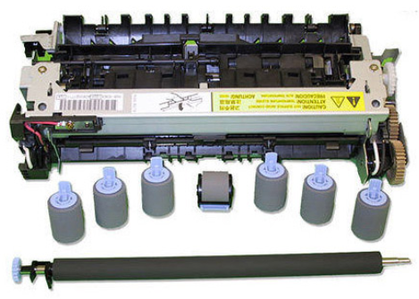
Maintaining and Troubleshooting Printers Printer Preventive Maintenance
Follow vendor’s guidelines when performing preventive maintenance to keep the printer in good condition
Replace consumables using the manufacturer’s recommendations
Keep the printer clean using the manufacturer’s instructions
Clean the print heads on inkjet printer
Use a HEPA vacuum cleaner to remove toner particles in a laser printer
Clean the heating element with isopropyl alcohol on a thermal printer
Keep the environment dry and clean
Store printers and supplies in a cool, dust-free, dry environment
Keep the glass clean on the copier / scanner
Notes:
11.4 - Maintaining and Troubleshooting Printers
11.4.1 - Printer Preventive Maintenance

Slide 24
Maintaining and Troubleshooting Printers Troubleshooting Printer Issues
Identify the Problem
The first step in the troubleshooting process.
A list of open and closed-ended questions is useful.
Establish a Theory of Probable Cause
Based on the answers received, establish a theory probable cause.
A list of common problems can be useful.
Test the Theory to Determine Cause
Test your theories to determine the cause of the problem.
A list of quick procedures to common problems can help.
Establish a Plan of Action to Resolve the Problem and Implement the Solution
A plan of action is needed to solve the problem and implement a permanent solution.
Notes:
11.4 - Maintaining and Troubleshooting Printers
11.4.2 – Troubleshooting Printer Issues

Slide 25
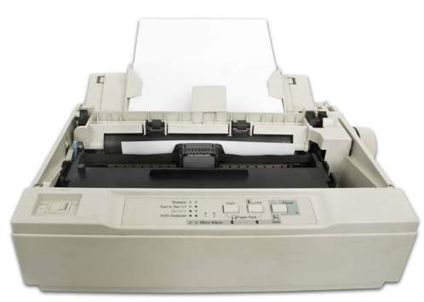
Maintaining and Troubleshooting Printers Troubleshooting Printers Issues (Cont.)
Verify Full System Functionality and Implement Preventive Measures
It is important to perform a full system check.
If applicable, implement preventive measures to avoid future problem recurrences.
Document Findings, Actions and Outcomes
Findings, repairs and notes should be documented.
This log can be helpful for future reference.
Notes:
11.4 - Maintaining and Troubleshooting Printers
11.4.2 – Troubleshooting Printer Issues (Cont.)

Slide 26
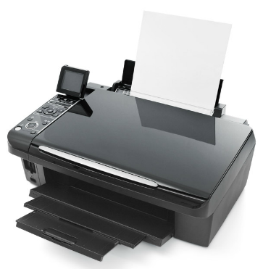
Maintaining and Troubleshooting Printers Common Problems and Solutions for Printers
Some printer problems are more common than others.
Printer problems are usually caused by hardware, application or configuration issues.
A few common printer problems include:
Printer is powered off or in standby mode.
Printer has an error, such as out of paper, paper jam, or out of toner / ink.
Printer does not print.
Printer prints unknown characters.
Print jobs are faded.
Users receive the message “Document failed to print”
Printer is printing incorrect colors.
Notes:
11.4 - Maintaining and Troubleshooting Printers
11.4.3 – Common Problems and Solutions for Printers

Slide 27
11.5 Chapter Summary
Notes:
Cisco Networking Academy Program
IT Essentials
Chapter 11: Printers

Slide 28
Chapter Summary Summary
This chapter introduced the printers. The following concepts from this chapter are important to remember:
Various types of printers and connections
Depending on the output, the printer is either suitable for commercial or home use.
Different speeds affect the quality of print.
Different printer connections, such as serial, parallel, USB, Firewire, or Bluetooth
Printer installation
Automatic installation from the computer
Tools from manufacturer’s website
CD supplied by the manufacturer
Share a printer
Preventive Maintenance
Keep the printer and supplies clean, dry, dust-free
Always follow safety procedures and manufacturer’s guidelines when servicing the printer
Notes:
11.5 – Chapter Summary
11.5.1 - Conclusion

Slide 30


Slide 31
Chapter 11 New Terms and Commands
airprint
cmyk
epp
gdi
hepa
hot swappable
inkjet
isopropyl
ocr
pcl
pdf
pdl
piezoelectric
wordpad
wysiwyg
xps
Notes:
New Terms and Commands

